Slide 1
Debugging & JavaScript Wrap-Up
BDPA Indy SITES
05/02/2020

Slide 2
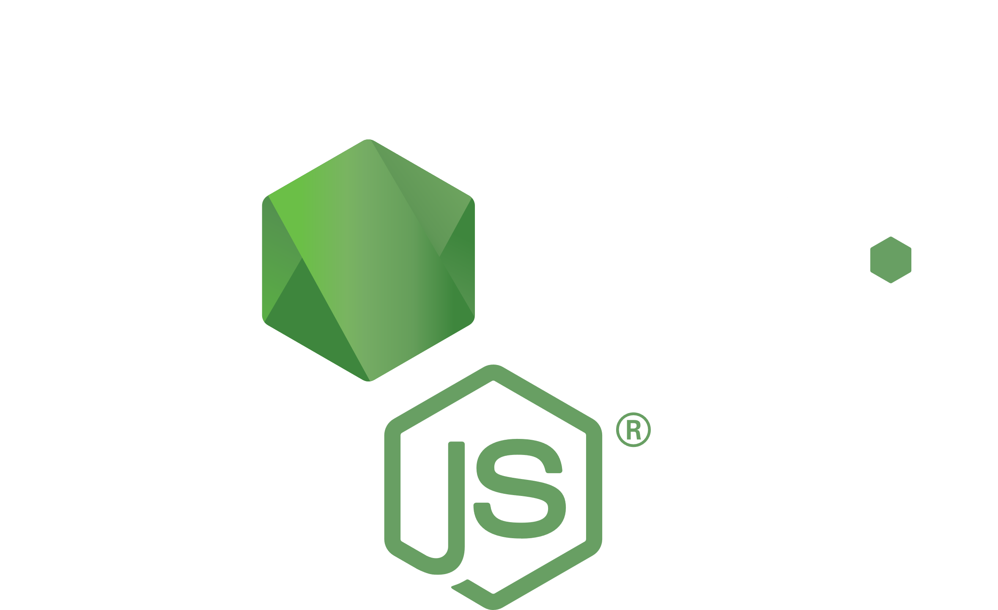
Node.js
Open source, cross-platform runtime environment for JavaScript
Built on Google Chrome's JavaScript Engine
Executes code outside of a traditional web browser
Interacts with Atom to run JavaScript code

Slide 3
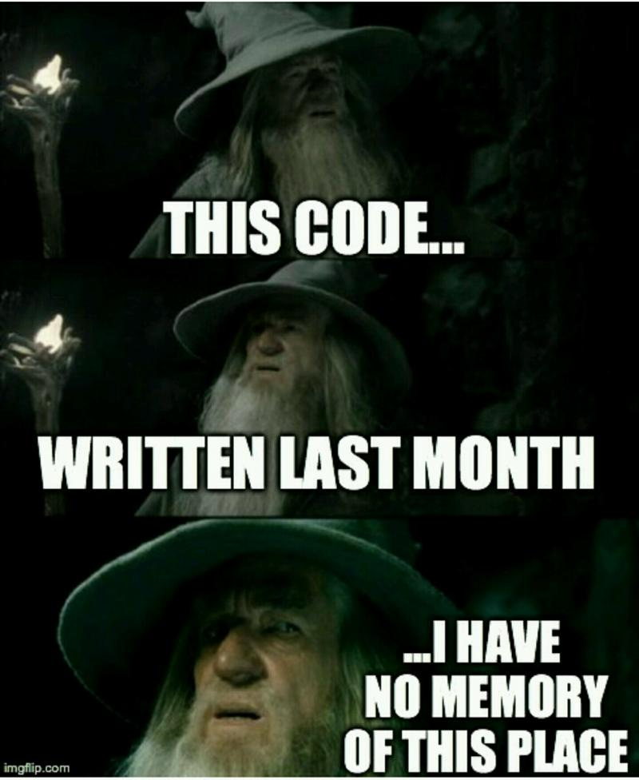
Commenting (please do it)
Comments are authored explanations of code that are ignored by the computer when executing code
// This is a single line comment
/* This is a comment is block comment.
It can span 2 or more lines. */

Slide 4
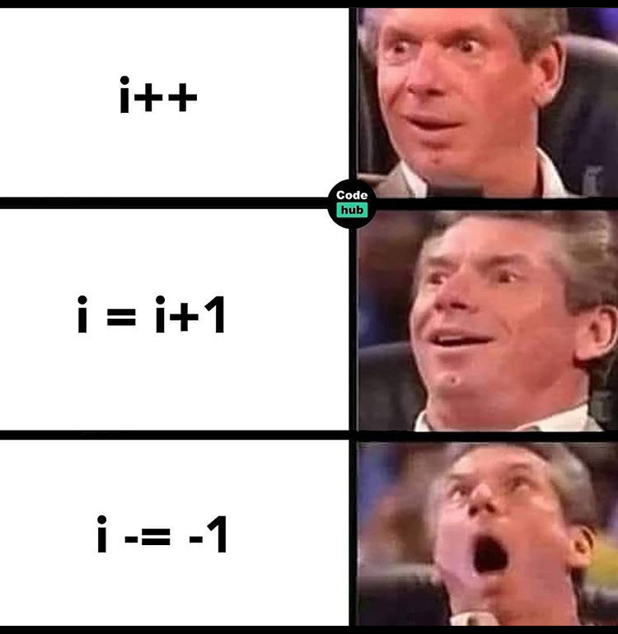
Good Commenting Practices
Stick with the simplest notations
Highlight confusing and/or important lines of code
Good code explains itself to a point
Proper variable naming goes a long way
Syntax and spacing increases readability
Objects do well with thorough comments

Slide 5
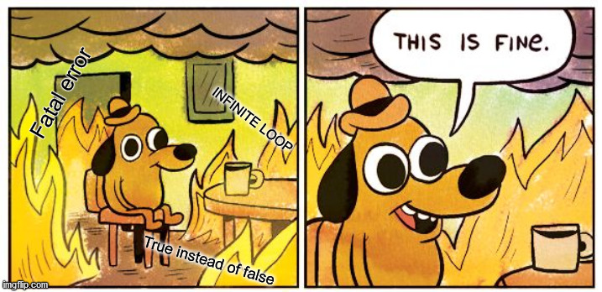
Debugging Basics
Formal definition: the process of finding and resolving defects or problems within a computer program that prevent correct operation.
Informal definition:

Slide 6
Breakpoints and Logging is Your Friend
console.log() displays JavaScript values in the debugger window
A great way to “print” the progress of your program and see results at given
You can set breakpoints in the JavaScript code.
Stops the JavaScript code
Allows you to observe multiple values at the time of breakpoint
Resume the code until another breakpoint is found or the code fully executes.

Slide 7
Common JavaScript Errors
Soft Errors
Hard Errors
Misused Assignment Operator
“Breaking” Statements
Floats are Weird
Trailing Commas
Undefined vs Null vs NaN
Variable Hoisting
Uncaught SyntaxError
Uncaught TypeError
Uncaught RangeError
Uncaught ReferenceError

Slide 8
Misused Assignment Operator
JavaScript allows you to assign variables within logic statements. …It’s awful
var x = 1; if (x == 10)
//if returns false
VS
var x = 1; if (x = 10)
//if returns true
VS
var x = 1; if (x = 0)
//if returns false

Slide 9
“Breaking” Statements
JavaScript will allow you to break a statement into two lines.
However you can not split a string without a backslash
You can never break a return statement
var x = OR var "Hello World!"; x = 10;
var x = "Hello \ NOT var x = "Hello World!"; World!";
function myFunction(a) { var power = 10; return a * power; }

Slide 10
Floats are Weird
Floats are Numbers with decimals
JavaScript and a few other languages are terrible at float addition
var x = 0.1; var y = 0.2; var z = x + y // the result in z will not be 0.3
var z = (x * 10 + y * 10) / 10; // z will be 0.3

Slide 11
Trailing Commas
Trailing commas are legal syntax but break everything
Internet explorer will crash and the program will lag in other browsers
var person = {firstName:"John", lastName:"Doe", age:46,}
var points = [40, 100, 1, 5, 25, 10,];
Remember that commas in the middle of arrays are okay
var points = [40, 100, , 5, 25, 10];

Slide 12
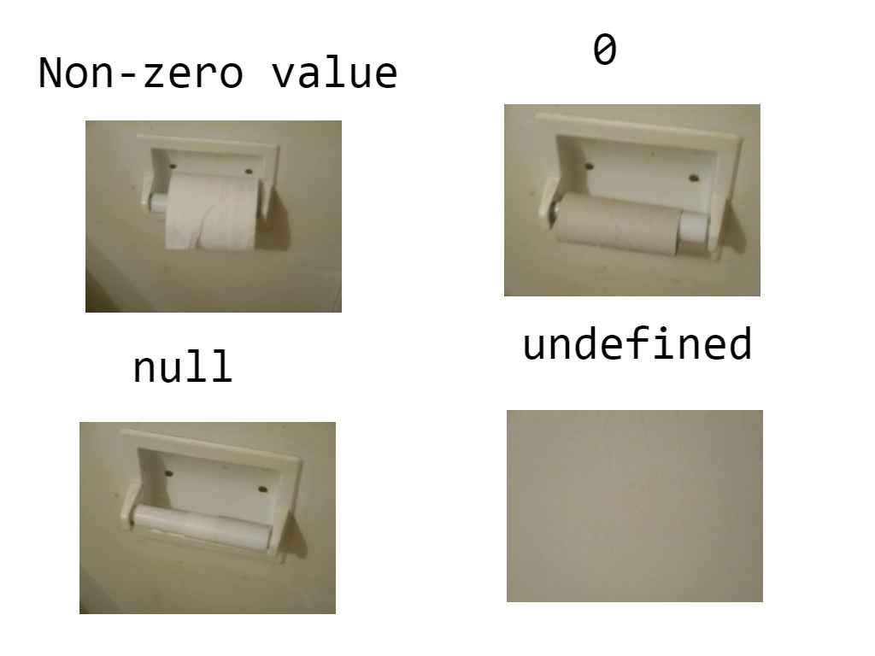
Undefined vs Null Vs NaN
Undefined is the value of a declared variable that is not initialized
Use if (typeof myObj === "undefined")
Null is a assigned value that represents nothing
Do NOT use if (myObj === null) since it will cause an error if it is undefined
NaN stands for Not-a-Number and results from a string that cannot be parsed
EX: “Banana” – 10 = NaN

Slide 13
Variable Hoisting
In JavaScript, a variable can be declared after it has been used.
Hoisting is JavaScript's default behavior of moving all declarations to the top of the current scope
x = 5; // Assign 5 to x var x;
JavaScript only hoists declarations, not initializations.
var x = 5; // Initialize x var string = x + " " + y; // Displays “5 undefined” var y = 7

Slide 14
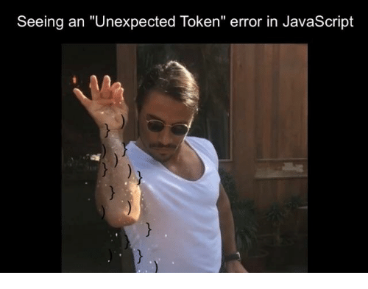
SyntaxError
for (let i = 0; i < 5,; ++i) {
console.log(i);
}
// SyntaxError: expected expression, got ‘)’
Tokens: These are words or symbols used to specify the logic of the application. These include things like +, -, ?, if, else, and var.
Control characters: A subset of tokens which are used to direct the “flow” of the code into code blocks.

Slide 15
Uncaught TypeError
var foo;
var temp = foo.bar
//Uncaught TypeError: Cannot read property ‘bar’ of undefined at <anonymous>:1:5

Slide 16
Uncaught RangeError
var arr = new Array(1);
function recursive(arr) {
arr[0] = new Array(1);
recursive(arr[0]);
}
//Uncaught RangeError: Maximum call stack size exceed

Slide 17
ReferenceError
function test {
var foo;
}
console.log(foo);
//ReferenceError: ‘foo’ is not defined

Slide 18
Error Handling
Instead of causing a crash that ends a program, you can anticipate and handle a potential error
For example an errors like an incorrect file path or password should not break everything
This provides a better user experience and aids in logging issues
The Error Object has two properties:
Property | Description
name | Sets or returns an error name
message | Sets or returns an error message (a string)

Slide 19
Try-Catch Statements
The try statement encloses the block of code you wish to capture errors for
The catch statement represents what should be done if an error is caught
The finally statement executes code regardless of whether the catch is triggered
try { adddlert("Welcome guest!"); } catch(err) { console.log(err.message);
return; }
finally {
x = 11;
}
//adddlert is not defined

Slide 20
Throw
The throw statement allows you to create your own custom errors
The exception can be a JavaScript String, Number, Boolean or Object
try { if(x == "") {throw "empty";} if(x < 5) {throw "too low";} if(x > 10) {throw "too high";} } catch(err) { console.log(err); } }

Slide 21

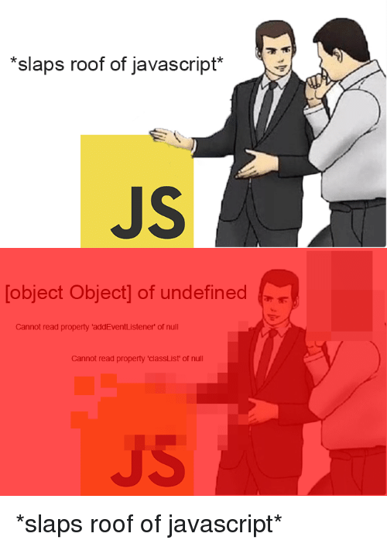
In Summary: Debugging is Life
It may feel like you spend more time debugging than coding
Even the best programmers get bugs in their code
Have a coding buddy help you debug when possible
Debugging does get easier over time
Syntax errors will decrease as you get comfortable with the language

